Slide 1
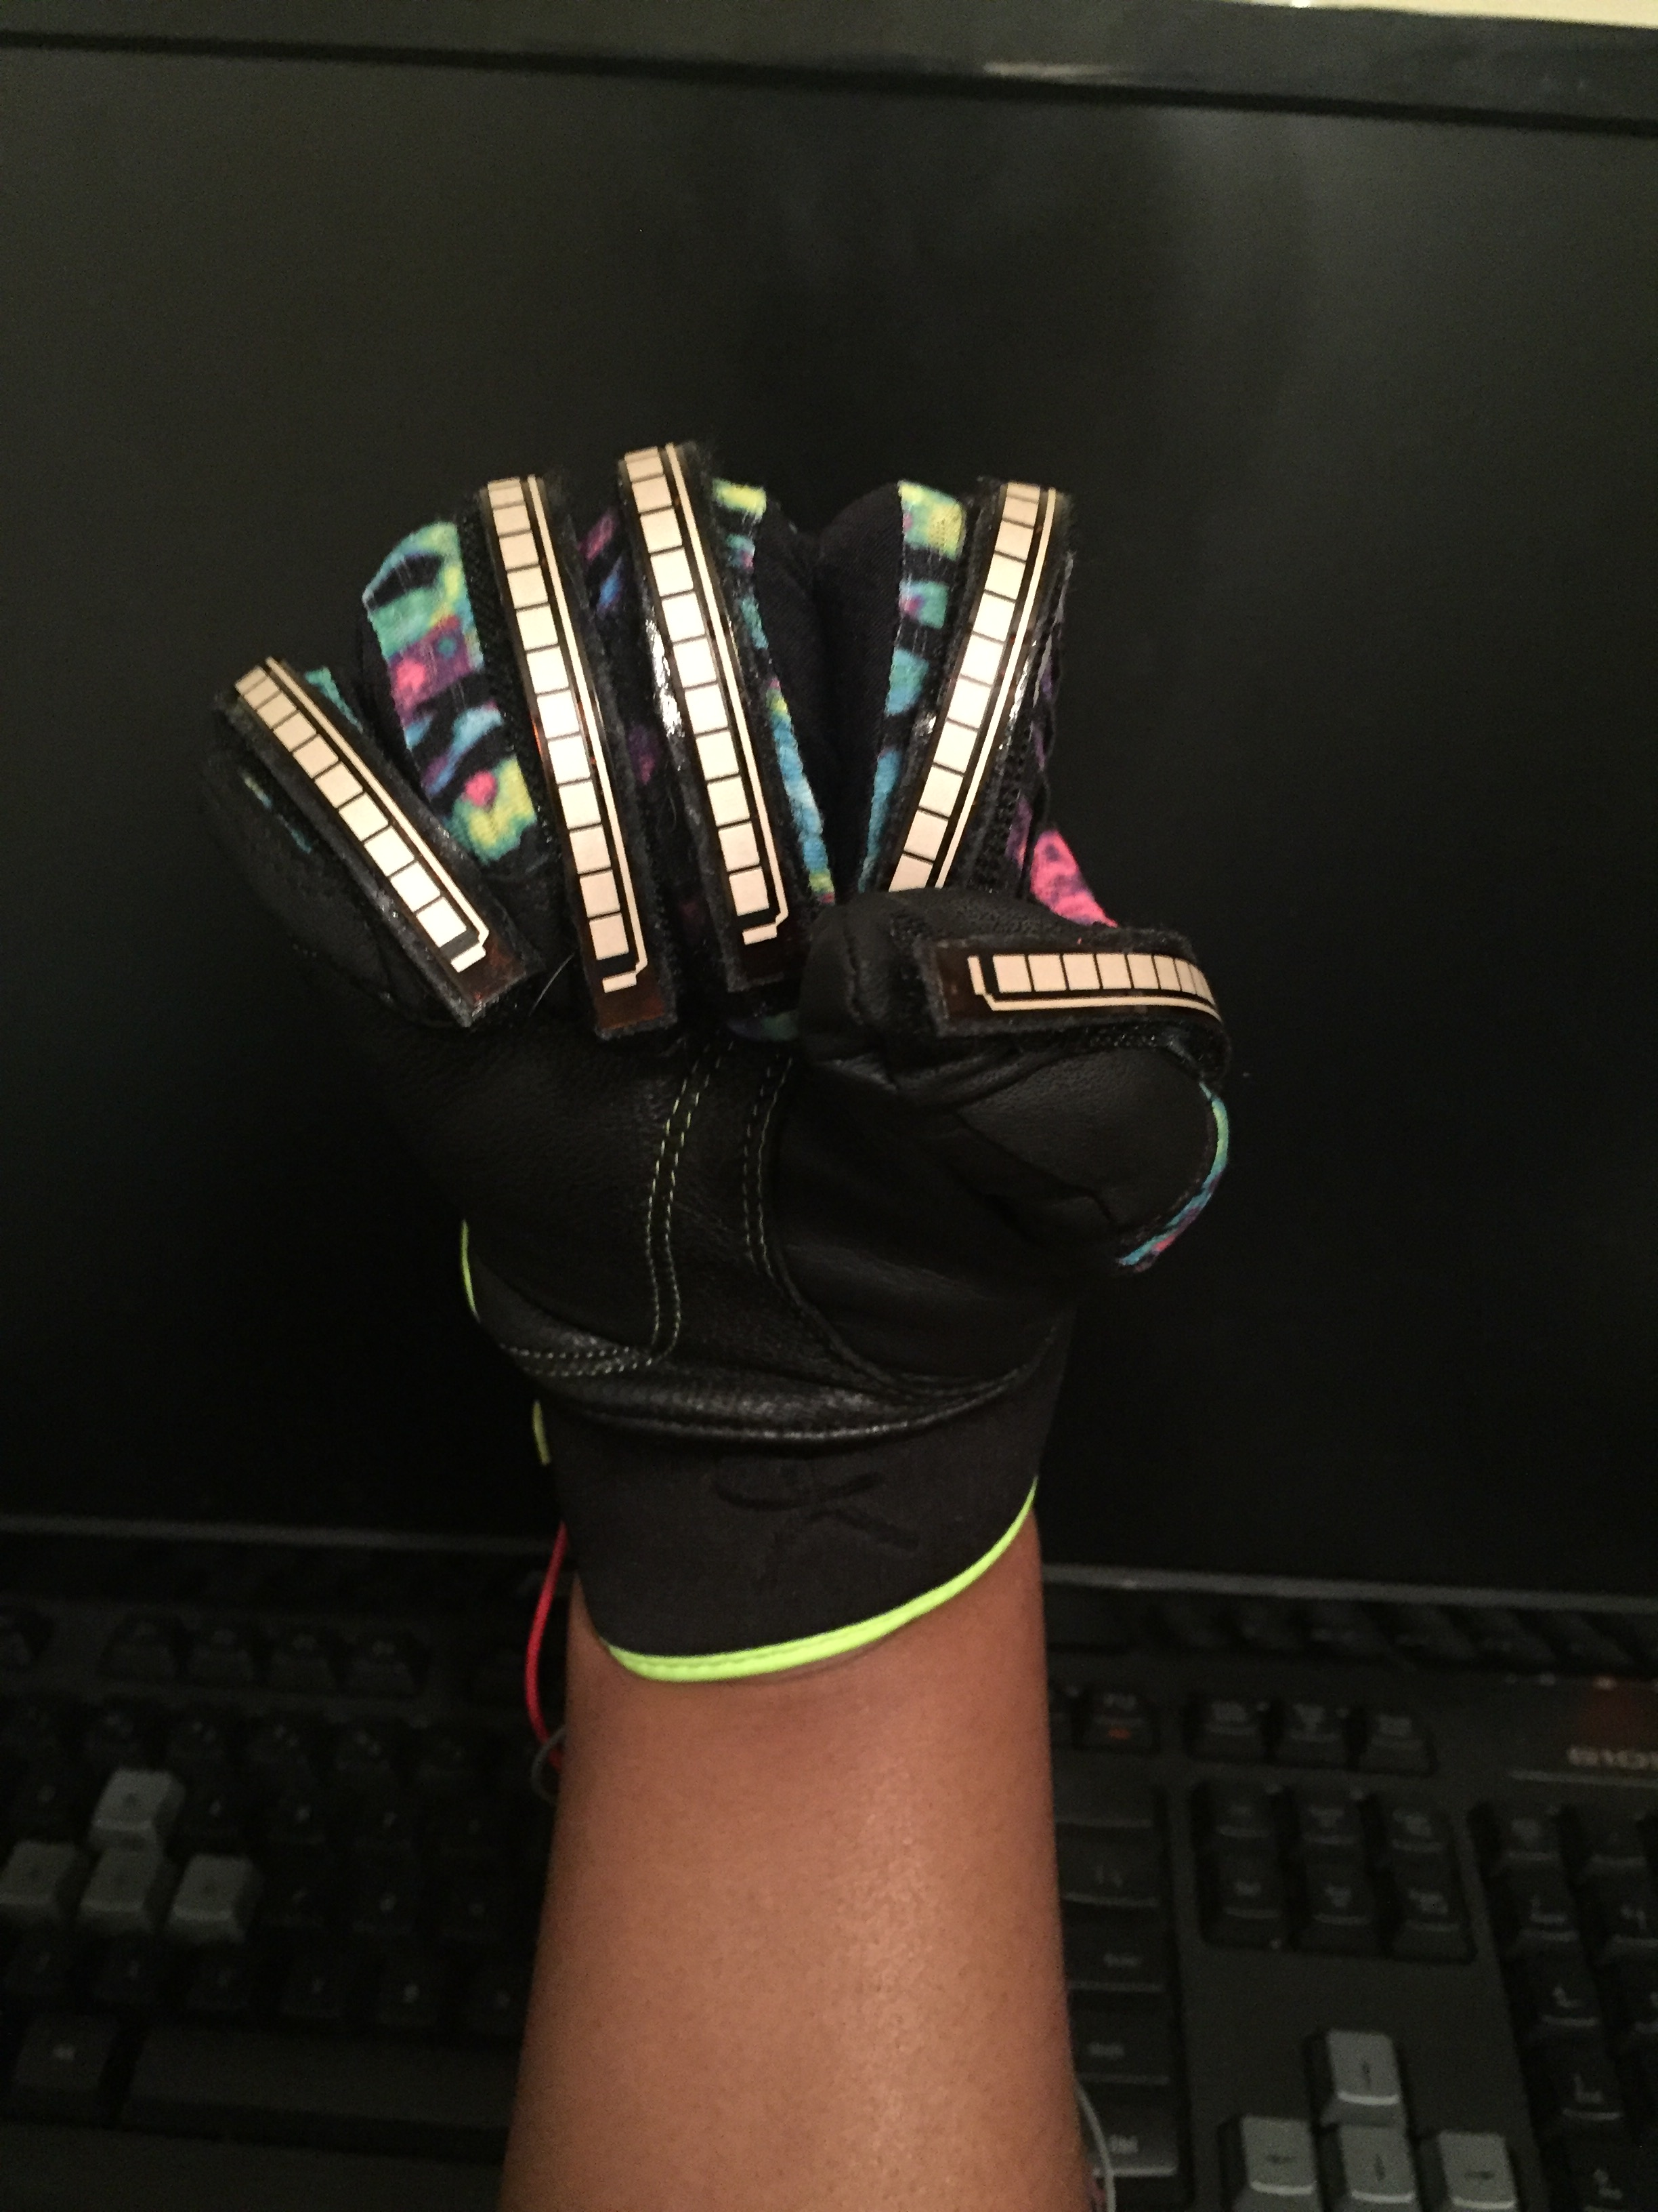
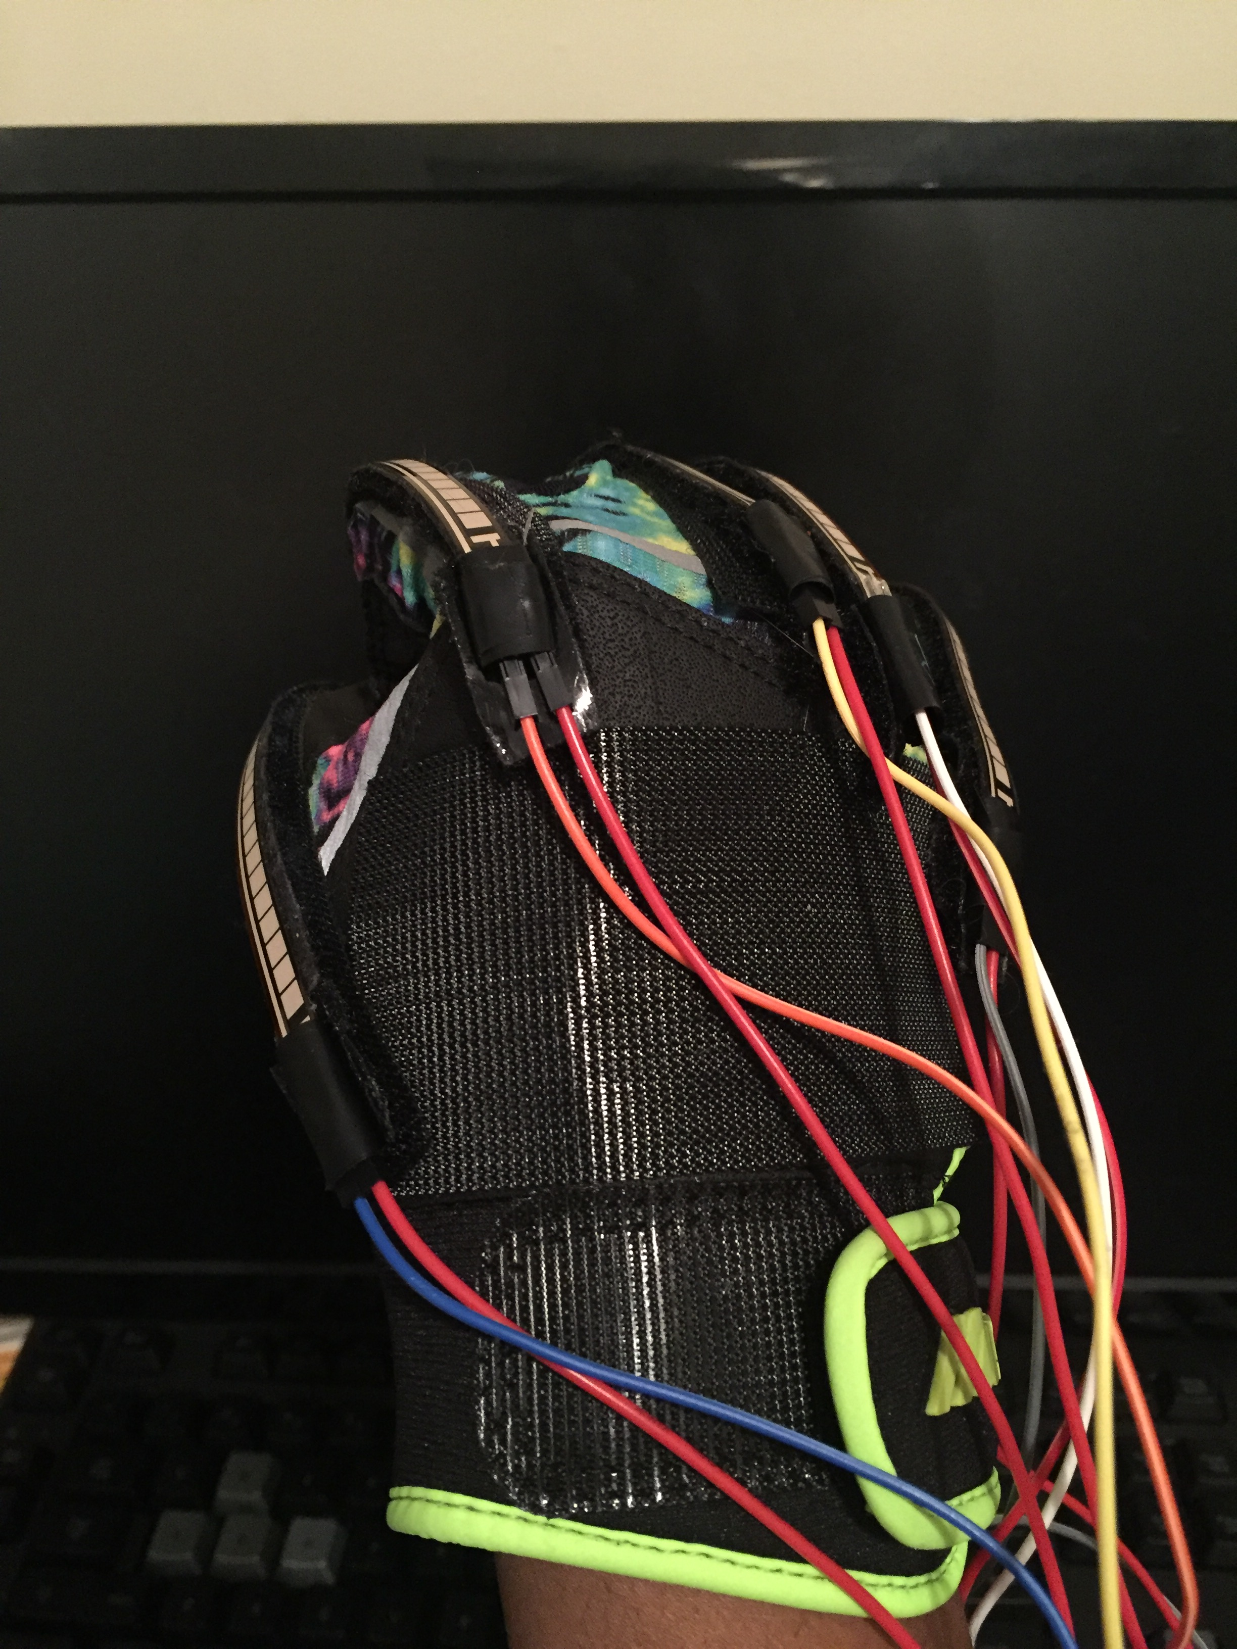
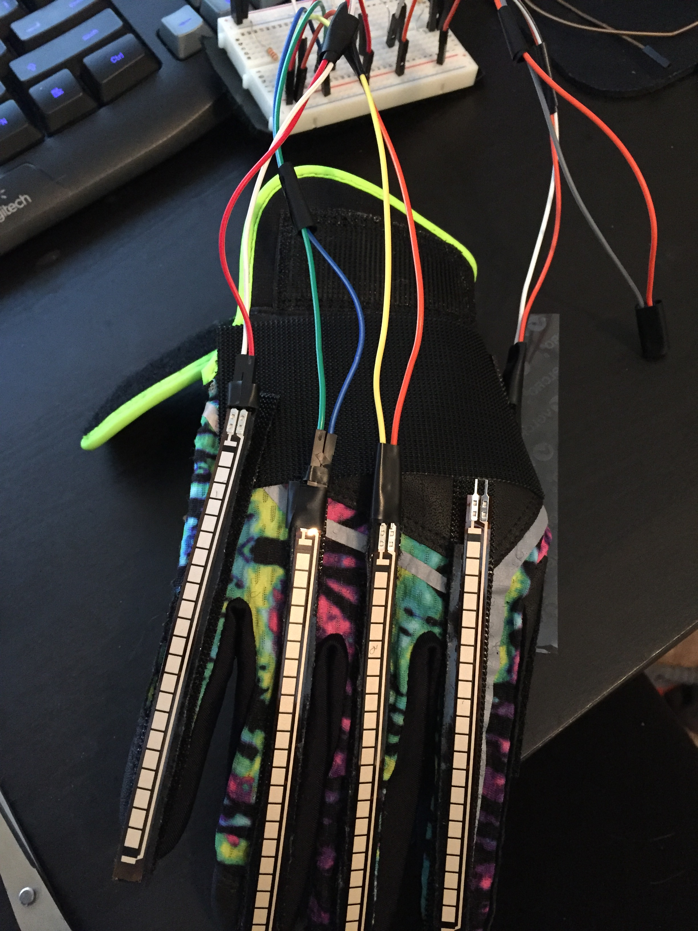
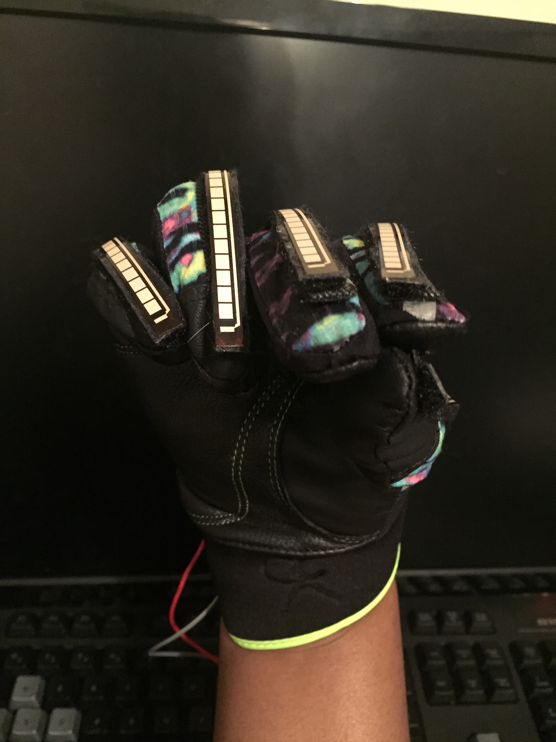
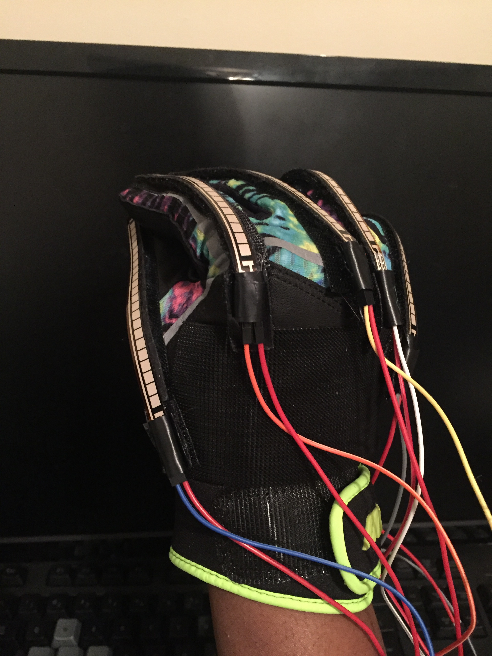
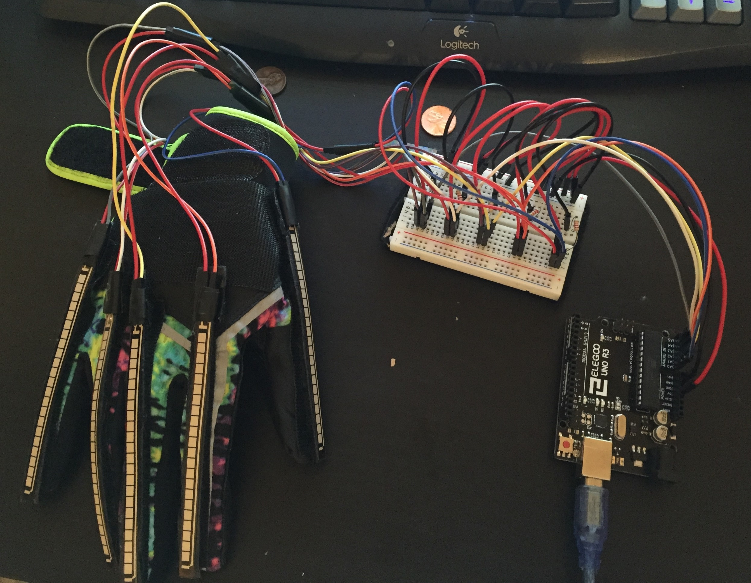
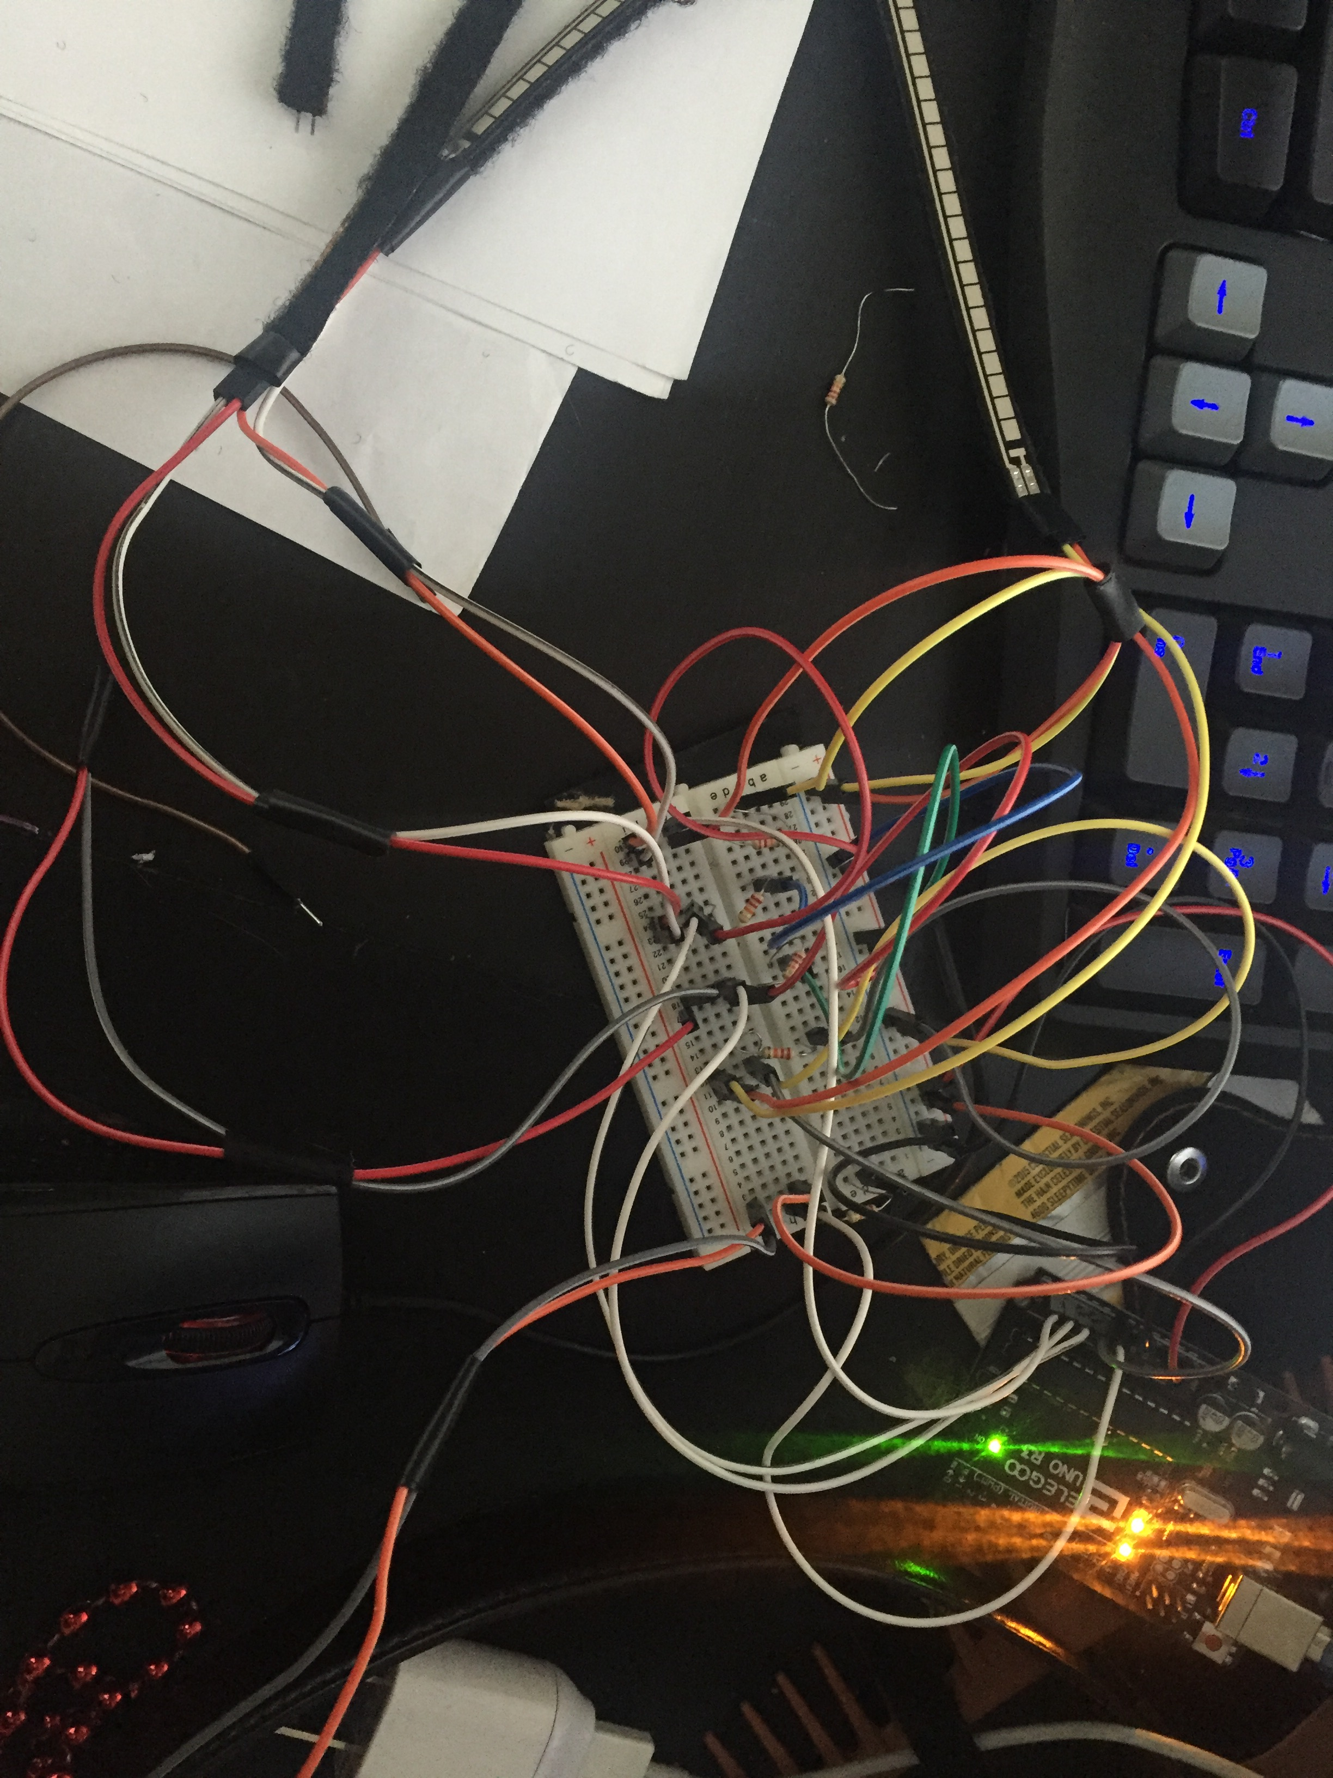
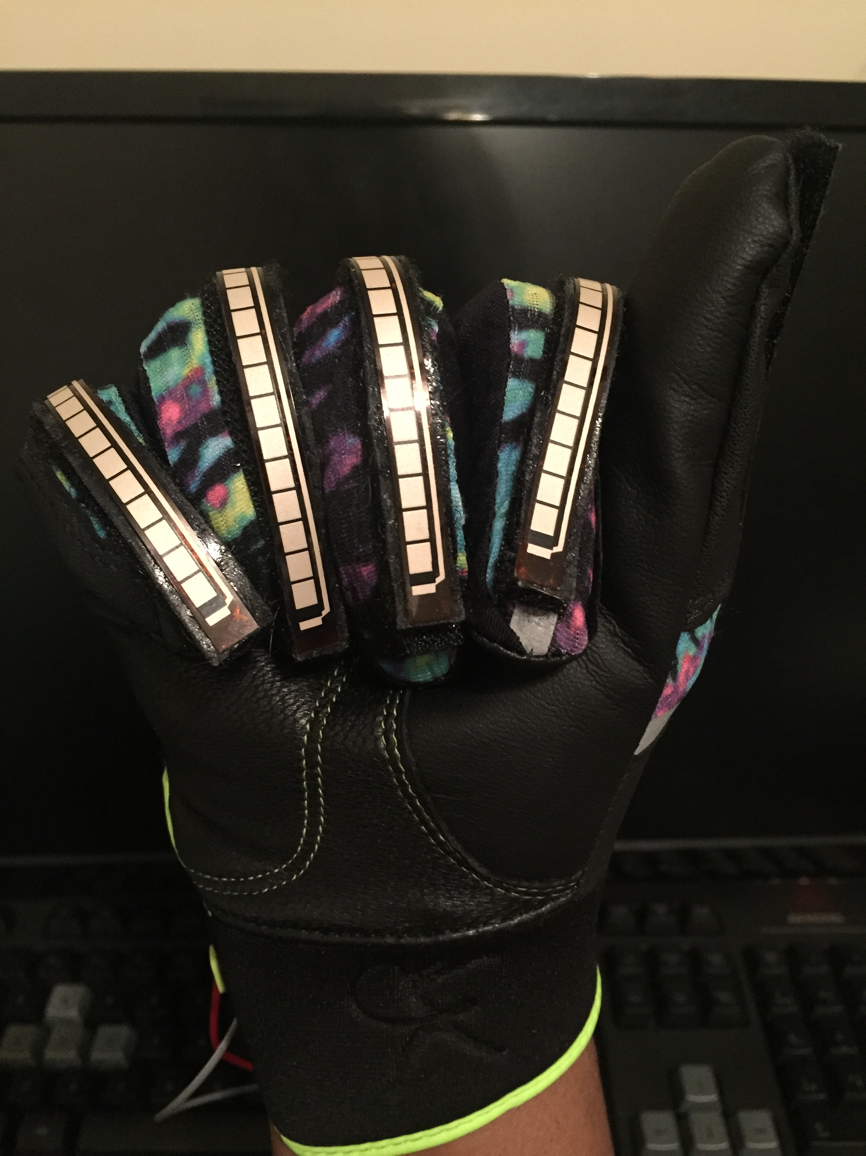
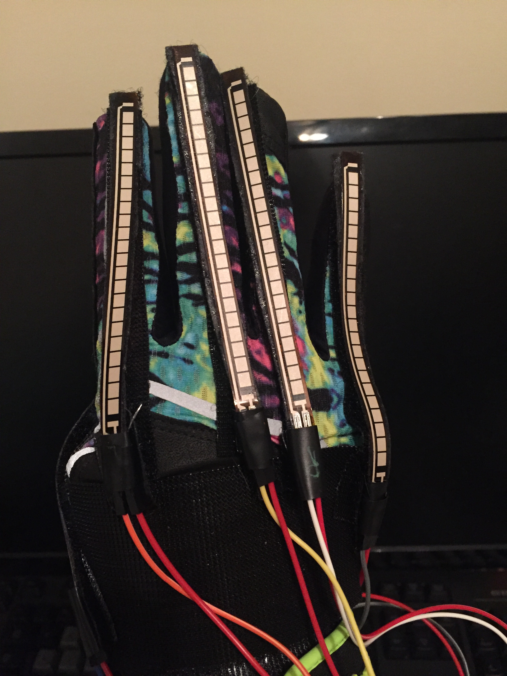
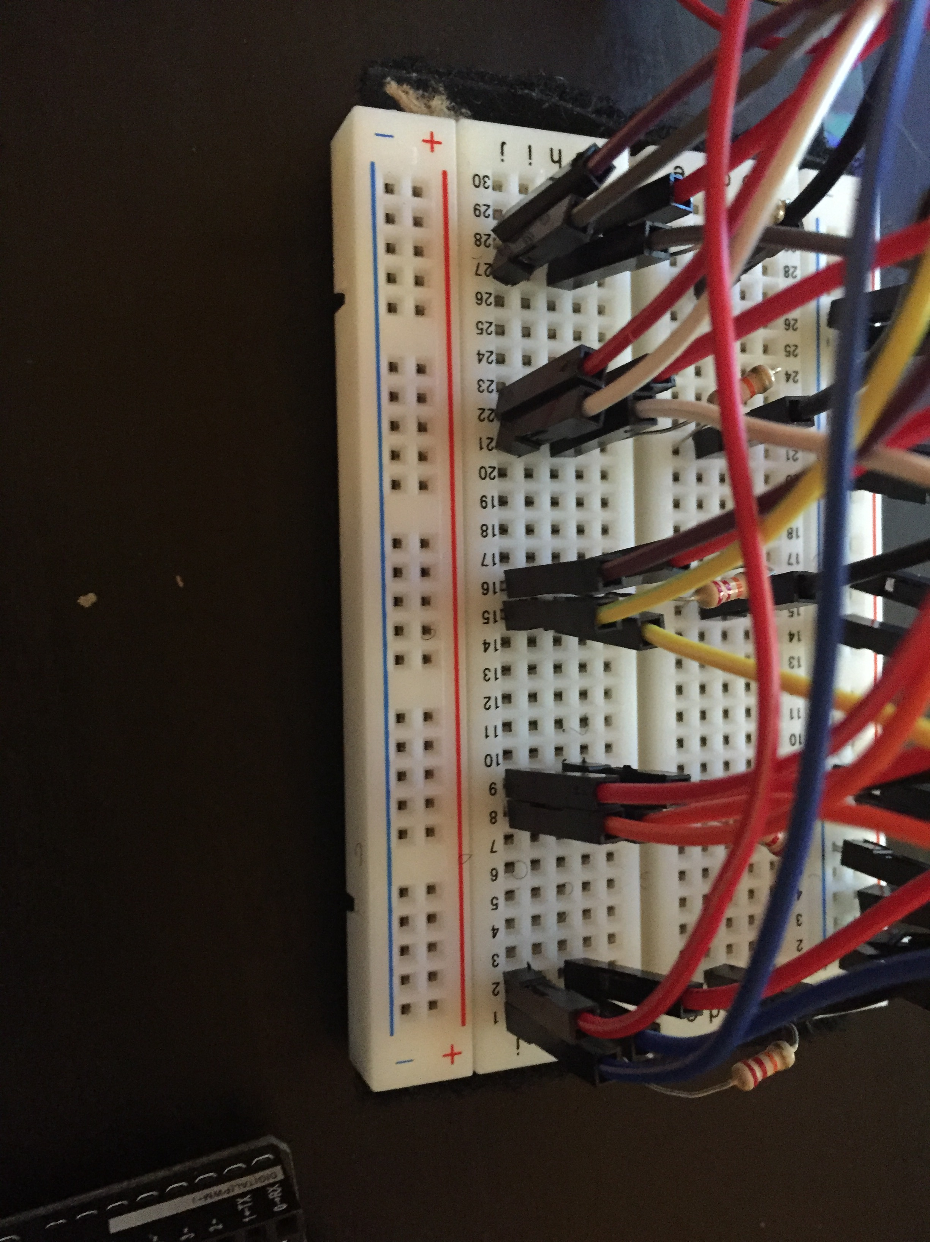
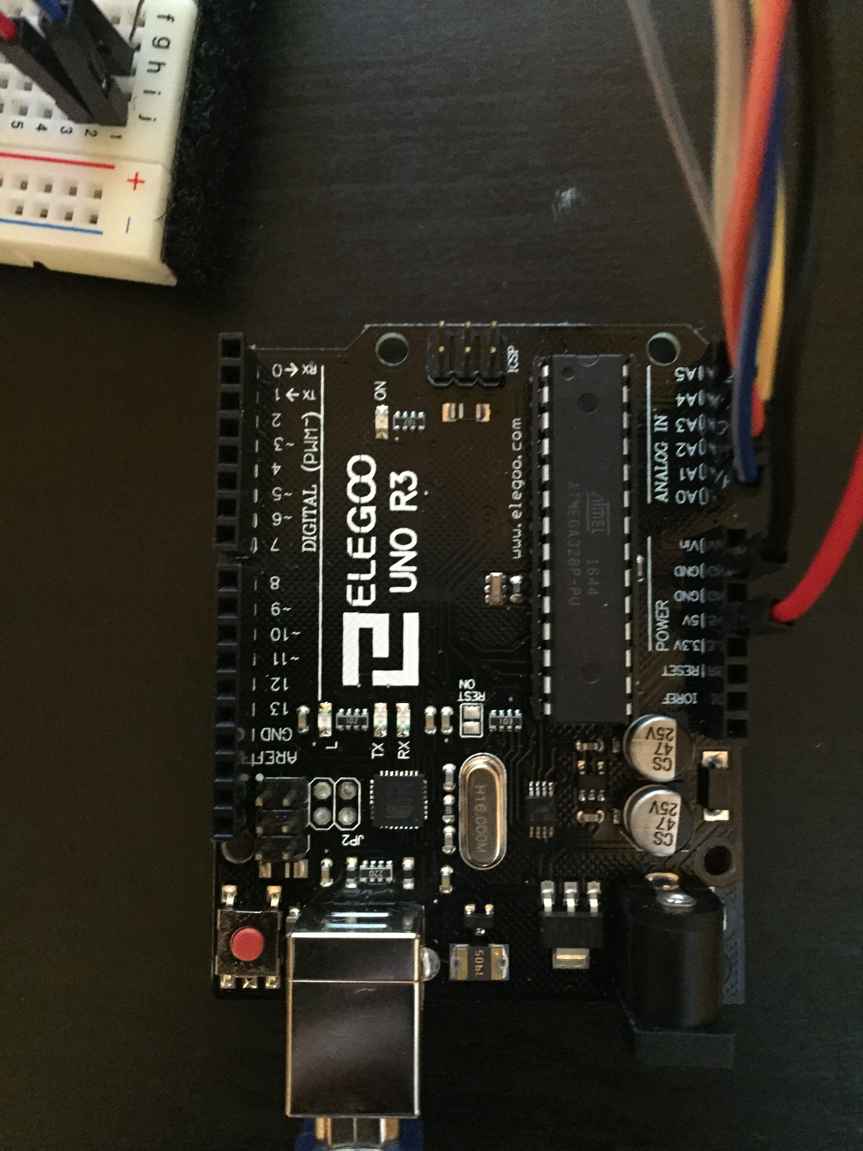
Ebisu: An Innovative User-Input Solution
Brittany Barnes and Yusef Ghouth
University of San Diego
Machine Learning Algorithm
Machine Learning Algorithm
Overview
Gestures
Machine Learning Algorithm
Perceptrons can only accurately classify linearly separable data, luckily the 5 dimensions provided by the flex sensors have proven to be enough to keep a wide variety of gestures linearly separated
Reading and classifying the data simultaneously also presents an obstacle, if the algorithm can’t classify the data fast enough it will get backed up and the user will experience a lag.
Because Ebisu molds to a user’s own preferences the user can encounter pitfalls where they create two gestures that are too similar to be distinguished from one another.
Ebisu is a user input device that ties together a wearable prototype, in the form of a glove, and a multiclass perceptron. Ebisu not only detects pre-learned gestures, but learns custom gestures on the go and molds to the user over time. Adding a large set of new accessibility to the user’s digital devices and opening the door for innovative apps that work with the wearable input solution.
Ebisu’s Machine Learning algorithm is a Multiclass Perceptron: A neural Network designed to observe datasets and classify them as one of many pre-learned classes. The twist is Ebisu’s algorithm can also recognize new patterns and categorize them on the go, making it a much more versatile tool.
Physical Prototype
Input
Class A
Class B
New Class
Class C
Overview
Physical Prototype
Yes in ASL (front)
Yes in ASL (back)
Ebisu uses 5 flex sensors on each of the gloves’ fingers in order to measure the degree in which the fingers are bent. The flex sensors are attached to the glove using Velcro to allow for adequate bending of the sensors. The Arduino Uno and breadboard provides us with an outlet to receive the data and feed into the Perceptron.
Future Implementations
Future Works
References
https://github.com/VRomanov89/EEEnthusiast/blob/master/MPU-6050%20Implementation/MPU6050_Implementation/MPU6050_Implementation.ino
https://learn.sparkfun.com/tutorials/flex-sensor-hookup-guide
https://people.ece.cornell.edu/land/courses/ece4760/FinalProjects/f2015/akl52_amb493_jc957/akl52_amb493_jc957.old/akl52_amb493_jc957/
4.https://www.youtube.com/watch?v=M9lZ5Qy5S2s
Full implementation of ASL Translation and commands
Incorporating Accelerometer into Ebisu Glove
Creating a software suite that will allow Ebisu to directly control an operating system
No in ASL (front)
No in ASL (back)
Gesturing
Data Generation
Perceptron Training
Gesture Recognition
Command Prompt
Close
Open
“A” in ASL
“B” in ASL

